Slide 1
Connect 4
Austen Lowder, Dennis Beaver

Slide 2
ABOUT The project
develop an AI agent that can play the game of Connect Four
optimally against a human player. Along with using the Minimax algorithm and using alpha bata pruning.
The minimax approach was selected due to how it searches and tries to find the most optimal next move for the AI to win against the player.

Slide 3
Classes
We have four classes Aiplayer, ConnectFourBoard, ConnectFourGame and PlayConnectFour.
These classes are set up to dffferent things the Aiplayer trys to pick the best move using the minimax algorithm. The ConnectFourBoard and ConnectFourGame both try to setup the board and the functions we need to traverse it. And PlayConnectFour just lets you play the game.

Slide 4
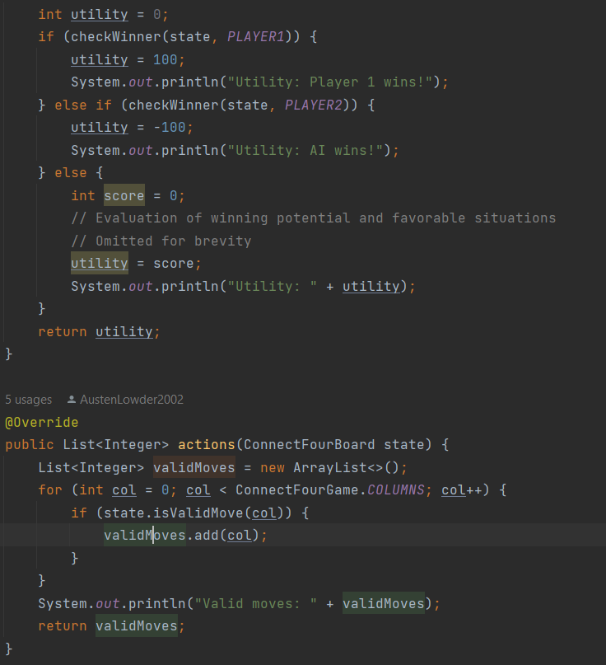
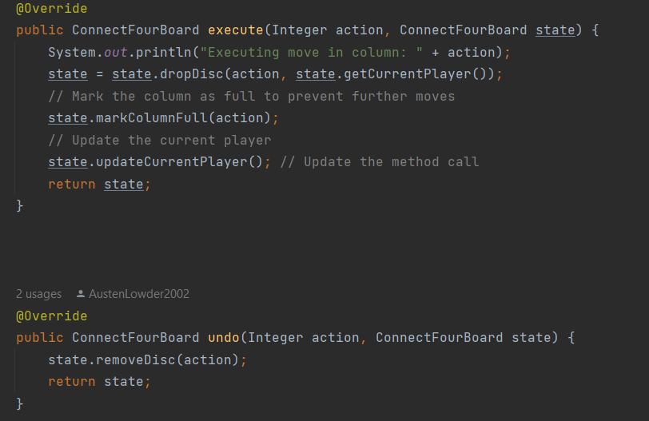
Overwritten functions for game

Slide 5
THANK YOU

